Slide 1
Best neighborhoods in Chicago to open a restaurant

Slide 2
The Business Problem
Problem description: Opening a restaurant in Chicago where competition and crime rate is low.
Target audience: people who would like to open a restaurant in Chicago at a safe neighborhood with relatively low competition.
Why it is important:
Low competition is better.
Customers prefer safer areas.
NOTE: During my analysis I will concentrate on the more serious, more violent crimes. Because in my opinion more violent crimes matter the most.

Slide 3
The Data
1. Chicago crime data
I used the Chicago's city official website for crime data. The latest data available is from 2018, so I used that. After downloading the CSV I converted it to a DataFrame. As I mentioned above I concentrated on the more serious/violent crimes.

Slide 4
I droped lines considering less serious/violent crimes:
burglary
concealed carry license violation
criminal trespass
deceptive practice
gambling
interference with public officer
liquor law violation
motor vehicle theft
non-criminal
non-criminal (subject specified)
obscenity
other narcotic violation
other offense
prostitution
public indecency
public peace violation
theft

Slide 5
I concentrated on the following type of crimes:
arson
assault
crim sexual assault
criminal damage
criminal sexual assault
homicide
human trafficking
intimidation
kidnapping
narcotics
offense involving children
robbery
sex offense
stalking
weapons violation

Slide 6
Chicago has 77 neighborhoods. I checked the (total number of crimes)/(neighborhood population) for neighborhood and I continued with the 20 safest neighborhoods.

Slide 7
2. Community areas in Chicago
The name of the community areas can be found on Wikipedia. I will get the name of the areas and the population from this source. Unfortunately, this does not contains the coordinates, so I will use geolocator to the latitude and longitude information.

Slide 8
3. Foursquare
I used foursquare to check competition in the safest 20 neighborhoods. I selected those wich has less than 10 restaurants.

Slide 9
Methodology
I downloaded the Chicago crime information as a CSV format. I converted the CSV into a pandas dataframe. I dropped all unnecessary columns and those rows which did not have the longitude and longitude information. After this I dropped rows with less serios crimes. In the analysis section I will select the 20 most peaceful neighborhoods.
The crime dataset did not include area information such as: the name and population of the area. Fortunately, this information is on Wikipedia. I used pandas again to get this info. However I was still missing the latitude and longitude information. I used the geolocator to get this information.
In the analysis section I will performed the following:
I selected the 20 safest neighborhoods. I checked the (total crime of the given area)/ total population of the given area.
I used forsquare to check competition.
In the conclusion section I will make the recommendations regarding where to open a restaurant.

Slide 10
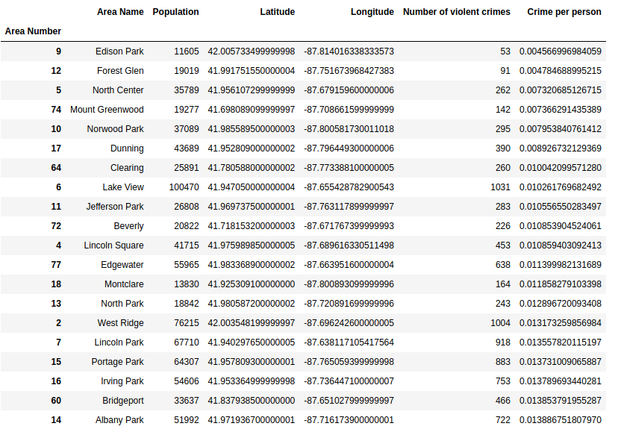
Analysis
During my analysis I found, that the followings are the top 20 safest neighborhoods of Chicago:

Slide 11
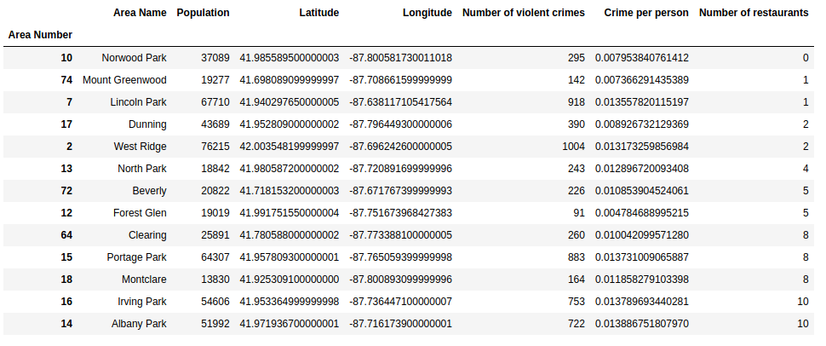
I continued my analysis with checking the number of restaurants in the neighborhoods mentioned above. The following neighborhoods have less than 10 restaurants:

Slide 12
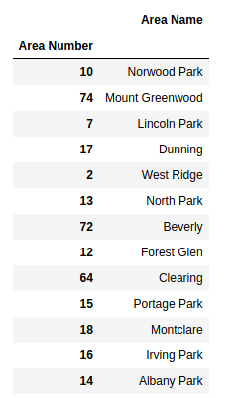
Results and Discussion
According to my analysis the following neighborhoods have low crime rate and low competition:

Slide 13
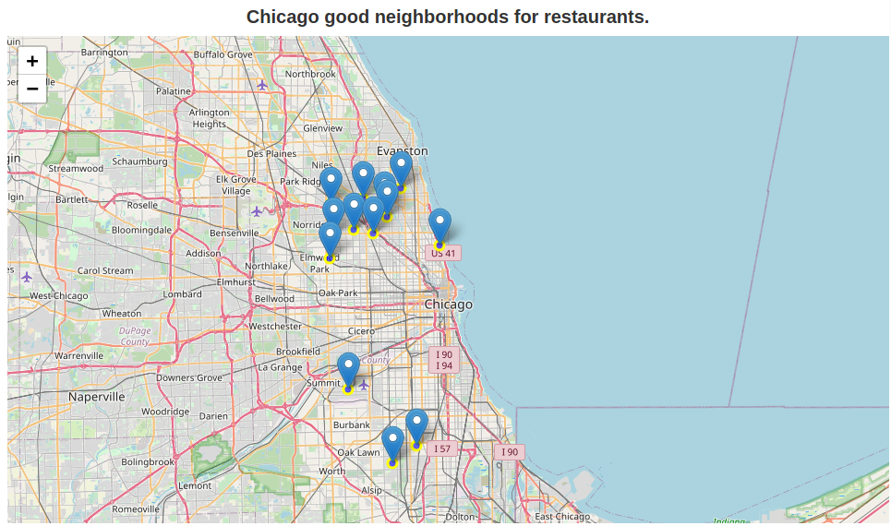

Slide 14
Conclusion
The goal of the project was to identify safe neighborhoods in Chicago with quite low competition in food services. During my analysis I concentrated on the more serious crimes.
I was able to identify 13 neighborhoods. I would concentrate on the selected neighborhoods located in the north, since there are a number of good candidates very close to each other.

